Slide 1
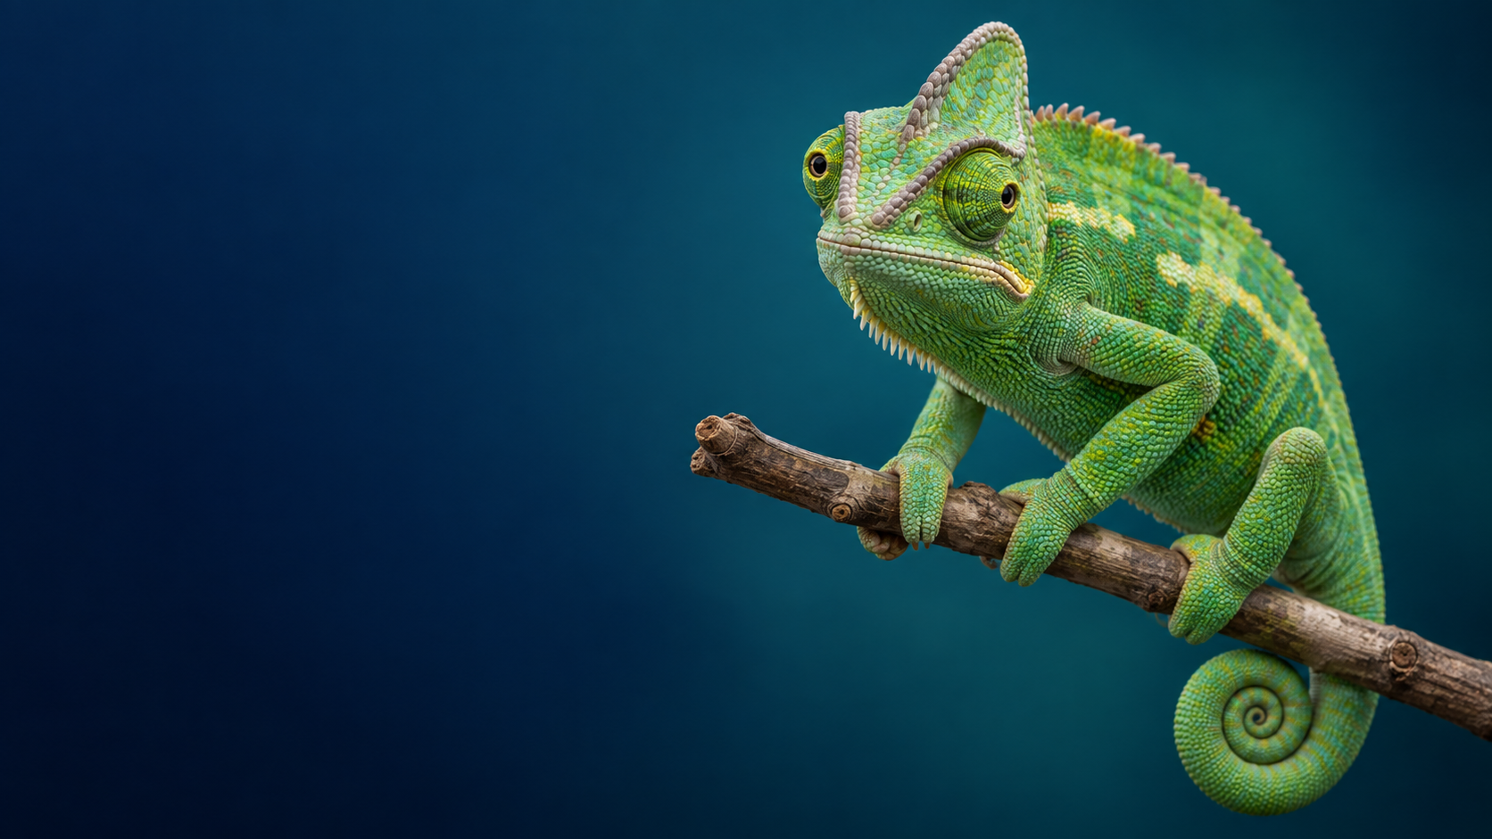
A03 • NEURAL NETWORK ZOO
CNN Chameleon
From biological neurons to visual learning
Group 4 | ITAI 2376
Neural Network Zoo
Notes:
Opening idea: We chose the chameleon because we wanted the animal to help explain the network, not just decorate the slide. Its wide-ranging eye movements give us a visual entry point into how CNNs examine regions of visual data.
Source for chameleon eye behavior: Katz et al. (2015), Journal of Experimental Biology, 218, 2097-2105, doi:10.1242/jeb.113084.

Slide 2
PROJECT INTRODUCTION
Why the CNN Chameleon?
Our guiding question
How can a computer start with a grid of numbers and eventually decide what is in an image?
Why a chameleon?
• Its eyes can survey different directions, giving us a natural visual analogy for examining a scene.
• The analogy stops there: a CNN does not literally “look around.” It applies mathematical filters to image data.
• That distinction helps us separate biological inspiration from the actual computation.
IMAGE DATA
LOCAL PATTERNS
FEATURES
PREDICTION
We will follow the information, not just memorize the terminology.
Notes:
Keep this slide quick. Main point: the animal is a teaching analogy, not the model itself. We use the chameleon to introduce the visual problem, then move to the actual neural-network mechanics.

Slide 3
PROJECT INTRODUCTION CONTINUED
Why CNNs were created
The story starts with a very practical vision problem:
How can a computer recognize the same thing when it moves around in an image?
1 THE PROBLEM
2 THE IDEA
3 THE REAL-WORLD TEST
A “7” is still a 7 — even when it moves.
Reuse the same small pattern detector.
Could it read messy human handwriting?
7
7
same
filter
MAIL
77005
7
A basic system could treat each location as a different problem.
1980 • Kunihiko Fukushima’s Neocognitron showed how layered visual detectors could recognize patterns even when their position changed.
Late 1980s • Yann LeCun and colleagues used trainable convolution-style networks for handwritten ZIP-code recognition.
So CNNs grew from a simple idea: recognize a useful pattern once, then look for it anywhere.
But what is the basic unit doing the learning? → the artificial neuron
Landmarks: Fukushima’s Neocognitron (1980) • LeCun et al., handwritten ZIP-code recognition (late 1980s)
Notes:
Keep this story conversational. Start with the familiar example: a handwritten 7 is still a 7 even if it moves on the page. That was the practical challenge. The key idea was to reuse the same local pattern detector in different places. Fukushima's 1980 Neocognitron was an important early model of this approach. LeCun and colleagues later showed convolution-style networks could be trained for a practical task such as handwritten ZIP-code recognition. Then segue: before explaining filters, we need the basic learning unit that all of these layers are built from — the artificial neuron.

Slide 4
James Delgado • NEURAL NETWORK BASICS
From a biological neuron to an artificial neuron
BIOLOGICAL NEURON
ARTIFICIAL NEURON
x1
x2
Σ
+ b
activation
output
x3
Receives
Dendrites and synapses receive signals from other cells.
Receives
Numerical inputs enter the artificial neuron.
Combines
The cell body integrates many incoming signals.
Combines
Weights change importance; the neuron adds the weighted inputs plus a bias.
Threshold
Membrane behavior determines whether an action potential occurs.
Activation
An activation function transforms the combined value.
Passes on
The axon carries the signal toward other cells.
Passes on
The output becomes input to neurons in the next layer.
Key idea
Artificial neurons borrow the idea of receiving, combining, and passing signals — not the full biology of a living neuron.
How do neurons become a network?
Each neuron passes its output forward. Groups of neurons working at the same stage form a layer.
INPUT
HIDDEN 1
HIDDEN 2
OUTPUT
Landmark: McCulloch & Pitts (1943) formalized an early mathematical neuron model.
Notes:
Use your A&P background here. Compare the biological neuron and artificial neuron as an analogy, then point out the limit: a biological neuron is an electrochemical living cell; an artificial neuron is a mathematical function. Then use the small network at the bottom to answer how layers form: one neuron's output becomes another neuron's input, and neurons at the same processing stage are grouped into a layer.

Slide 5
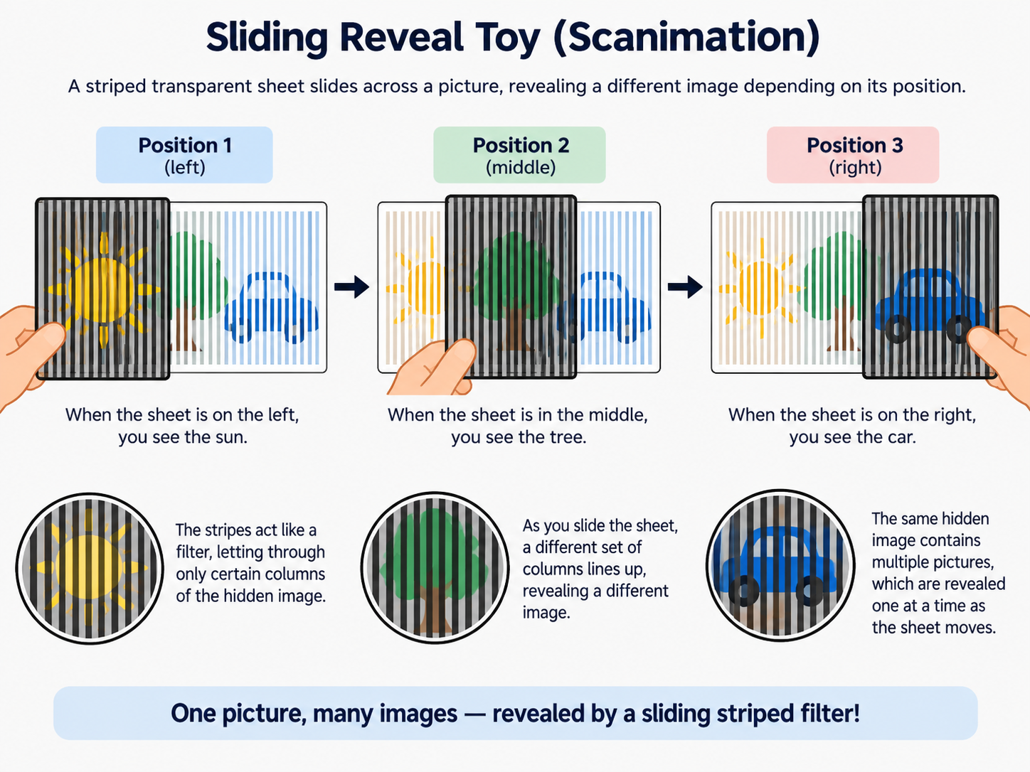
James Delgado • NEURAL NETWORK BASICS
Why a CNN adds convolution
FROM LAYERS TO CONVOLUTION
WHY IS IT CALLED 'CONVOLUTIONAL'?
A basic neural network gives us layers. But an image has a special structure:
The name comes from the operation itself.
Convolution comes from the Latin root convolvere, “to roll together.” In image processing, a small filter is combined with one local region, then reused/rolled across the image. That repeated local operation is why the network is called convolutional.
1
Pixels have neighbors
Edges and textures are local patterns, not isolated pixels.
Toy analogy: a sliding reveal toy (scanimation)
Edge-detection example
2
Patterns move around
0
0
0
0
0
The same edge can appear anywhere in the image.
0
0
0
0
0
-1
-1
-1
1
1
1
1
1
0
0
0
strong
response
1
1
1
1
1
1
1
1
3
Reuse one detector
1
1
1
1
1
CNNs use the same small filter across many local regions.
image region
edge filter
When the filter lines up with an edge, the response is strong. Then the same filter is reused in the next region.
Deep learning = many layers
CNN = layers designed to exploit local image patterns
The toy gives the intuition of a moving local window. A CNN filter also moves across the image, but instead of revealing a picture, it calculates a pattern response.
One small detector
reused many times
1980
Fukushima
Landmark: Fukushima’s Neocognitron (1980) was a major precursor to modern CNNs.
Notes:
Use this as the handoff from general networks into CNNs. First establish that layers are already familiar. Then ask what changes when the data is an image: pixels have neighborhoods, patterns can appear anywhere, and reusing one local detector is efficient. The scanimation image makes the moving local window intuitive. Then point to the edge filter: it calculates a response, not simply reveals the picture.

Slide 6
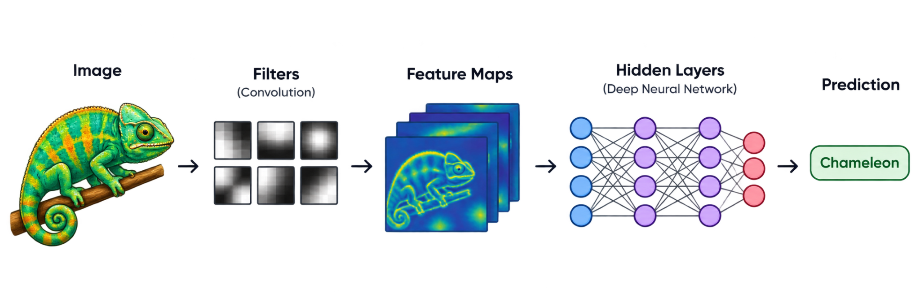
King Owusu • What is CNN
CNN Chameleon: How a CNN Sees an Image
Understanding Convolution
A convolutional neural network is a type of neural network designed especially for working with images and visual information.
Instead of looking at the entire picture at once, a CNN examines small regions of the image and learns the important patterns locally.
Main Components of CNN
Input Image
The image given to a convolutional neural network.
Filters/Kernels
Small matrices that scan across the image to detect visual patterns.
Feature Maps
Visual maps showing exactly where specific patterns were detected.
Hidden Layers
Process features hierarchically to gradually learn complex patterns.
Output
Uses final learned features to generate a prediction or classification.

Slide 7
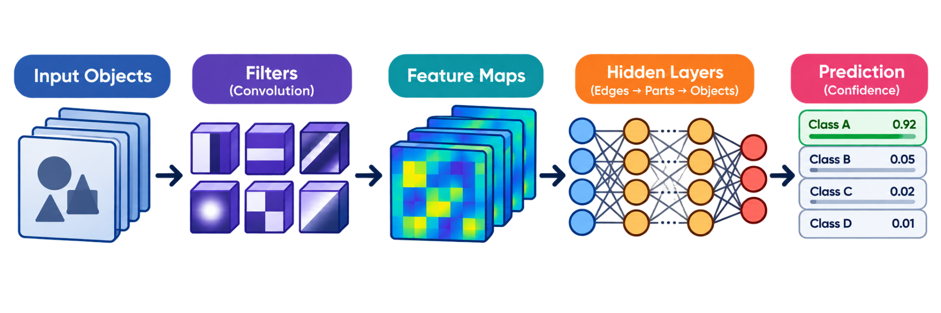
King Owusu • How Does CNN Learn Features
From Simple to Complex Features
Hierarchical Feature Learning
Early Layers: Detect simple features like edges, lines, and colors.
Middle Layers: Combine simple shapes to recognize curves and textures.
Deeper Layers: Assemble parts into complex objects and patterns.
How the Filter Works
The Chameleon Analogy
Imagine a small filter scanning across an image. At each spot, it looks for specific patterns to build a feature map. This local scanning allows the CNN to learn key features efficiently without needing to analyze the entire image at once.

Slide 8

ESTHER ODAIBO • PERSON 3 • CHAMELEON ANALOGY & VISUALS
How the CNN Chameleon “Sees”
The eyes introduce the scanning idea; the network performs the processing.
1
Image data
A picture enters as organized pixel values.
2
Local patterns
Small filters examine one region at a time.
3
Feature maps
Detected edges, colors and textures are mapped.
4
Deeper processing
Layers combine simple features into larger patterns.
EYES GATHER VISUAL REGIONS
5
Prediction
Final features support a label or classification.
THE KEY DISTINCTION
A chameleon gathers visual information with its eyes. A CNN scans numerical image data with mathematical filters.
8
Notes:
[Sources]
- Group 4, A03 Neural Network Zoo presentation, user-provided PDF, accessed September 10, 2026.
- Chameleon image extracted from the user-provided Group 4 presentation cover.
[/Sources]

Slide 9
ESTHER ODAIBO • PERSON 3 • CHAMELEON ANALOGY & VISUALS
Where the Analogy Works—and Where It Stops
The chameleon is a memory aid, not a literal model of a convolutional network.
WHERE IT WORKS
WHERE IT STOPS
1
Different regions
1
Biology vs. computation
Both direct attention to separate areas of a visual scene.
A chameleon uses living eyes and a brain; a CNN uses calculations.
2
Local information
2
Seeing vs. numbers
Nearby colors, edges and shapes provide useful clues.
A CNN receives pixel values rather than experiencing a picture.
3
Combined evidence
3
Scanning vs. understanding
Information from many regions contributes to recognition.
Pattern detection does not give the network human-like meaning.
CHAMELEON EYES
DO NOT EQUATE THEM
CNN HIDDEN LAYERS
Gather information
The eyes are not the hidden layers
Process features
Main takeaway: the chameleon explains visual scanning; filters and layers explain the actual CNN process.
9
Notes:
[Sources]
- Group 4, A03 Neural Network Zoo project overview and presentation, user-provided materials, accessed September 10, 2026.
[/Sources]

Slide 10
ZAIN AHMED • APPLICATIONS, LIMITATIONS & REFLECTION
Where CNNs Are Used in the Real World
CNNs are useful when a task depends on recognizing visual patterns in images or video.
1
Medical imaging
Helps detect patterns in X-rays, CT scans, and other medical images.
2
Self-driving
Recognizes lanes, road signs, vehicles, and pedestrians.
3
Security cameras
Analyzes visual data for objects or learned patterns.
4
Factory quality control
Inspects products and helps find visible defects.
5
Food and visual search
Classifies images by matching learned visual features.
WHY CNNs FIT IMAGES
CNN filters scan small regions, learn local patterns, and reuse those pattern detectors across the image.
10
Notes:
[Sources]
- Group 4, A03 Neural Network Zoo presentation, user-provided PDF, accessed September 10, 2026.
- Chameleon image extracted from the user-provided Group 4 presentation cover.
[/Sources]

Slide 11
ZAIN AHMED • APPLICATIONS, LIMITATIONS & REFLECTION
Limitations and Final Reflection
CNNs are powerful visual pattern learners, but their results still depend on data, training, and context.
WHY CNNs ARE USEFUL
LIMITATIONS
1
Local patterns
1
Training data
They focus on nearby pixels, edges, colors, and textures.
Biased or limited data can lead to weak predictions.
2
Feature building
2
Image changes
Layers combine small features into larger object patterns.
Lighting, blur, angle, noise, or rotation can affect results.
3
Reusable filters
3
No human understanding
The same filter can search for a pattern in many regions.
A CNN detects learned patterns, not human-like meaning.
APPLICATIONS
FINAL REFLECTION
CNN LIMITS
Real-world use
Useful, but not perfect
Evaluate outputs
Main takeaway: CNNs turn image data into learned features and use those features for prediction, but the final output should still be checked carefully.
11
Notes:
[Sources]
- Group 4, A03 Neural Network Zoo project overview and presentation, user-provided materials, accessed September 10, 2026.
[/Sources]

